Slide 1
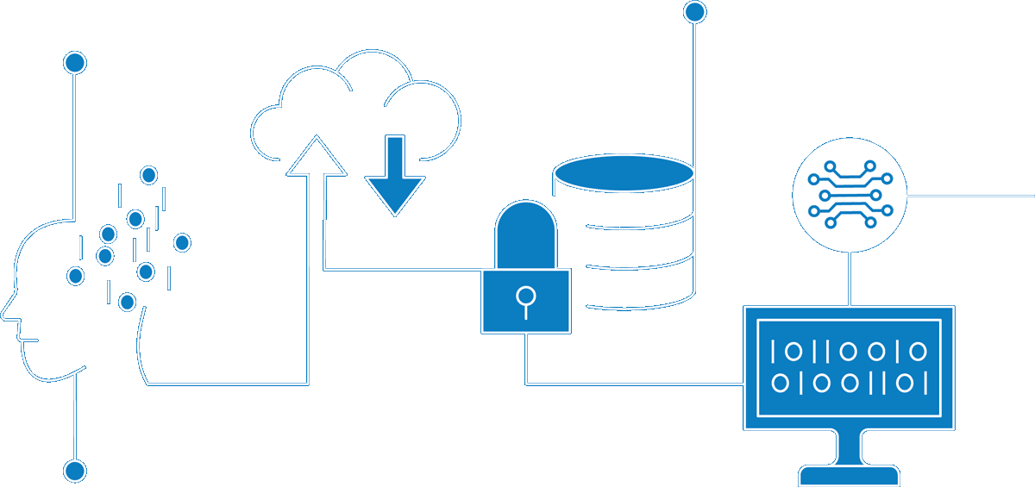
NationalGrid AI/ML
Author Nishit Ajwaliya
Date January 2022
Version v0.1
Status DRAFT

Slide 2
Summary
tbd

Slide 3
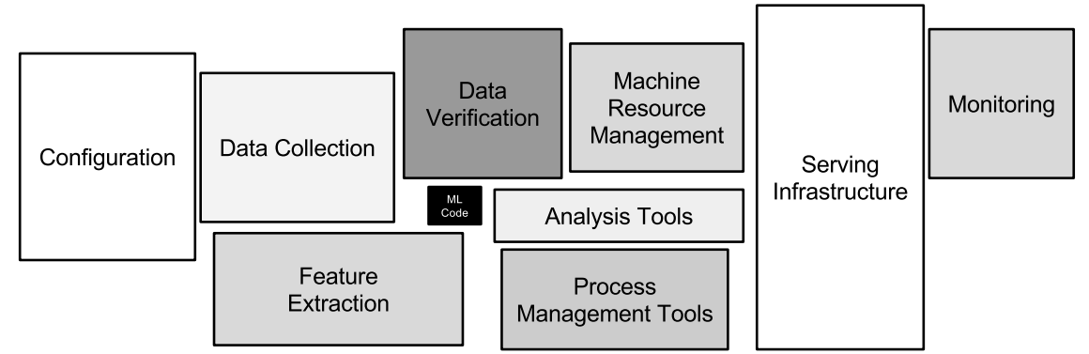
ML Algorithm is fraction of the code
*Source: https://proceedings.neurips.cc/paper/2015/file/86df7dcfd896fcaf2674f757a2463eba-Paper.pdf

Slide 4
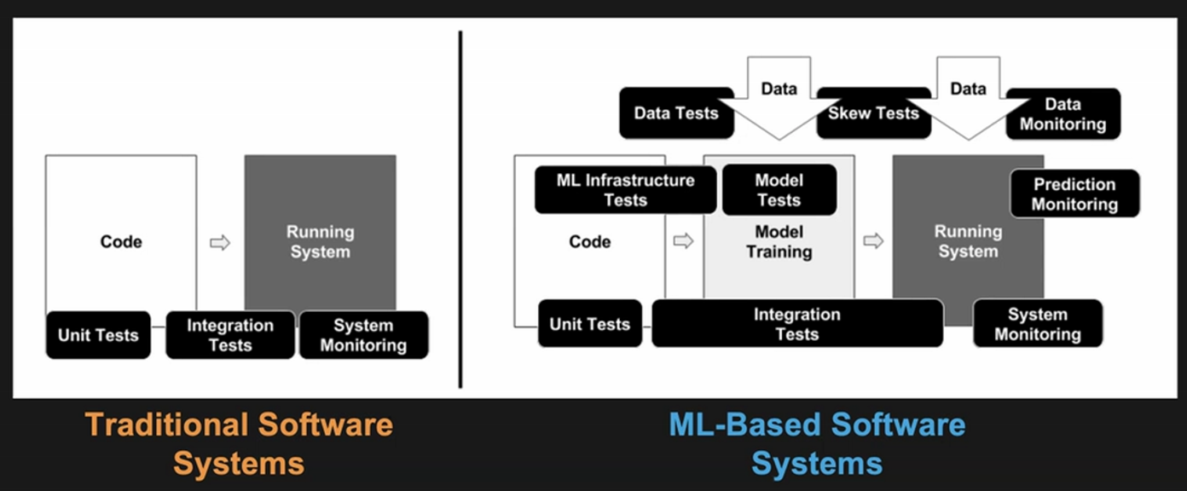
Traditional vs ML-Based Software development
*Source: https://research.google/philosophy/

Slide 5
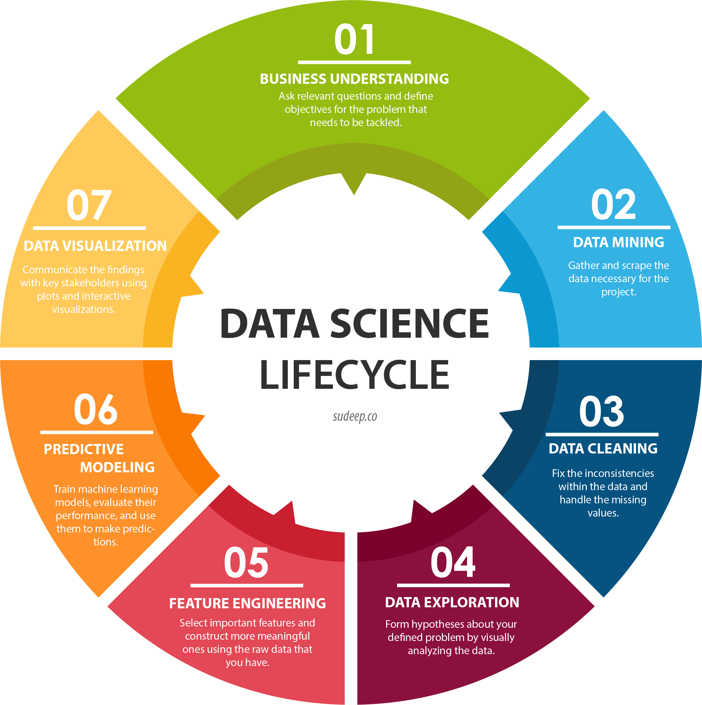
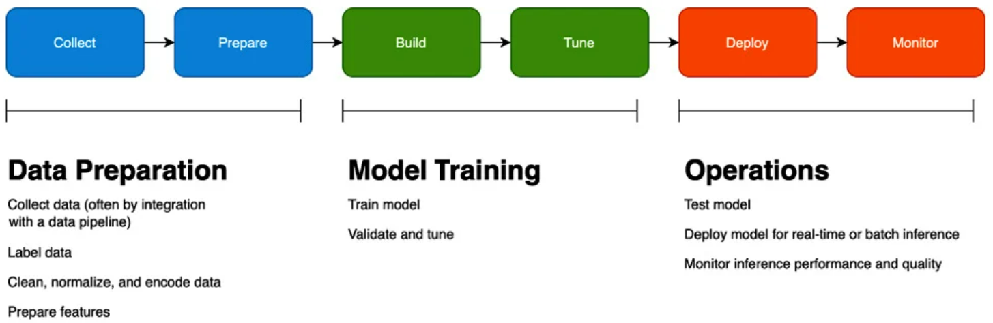
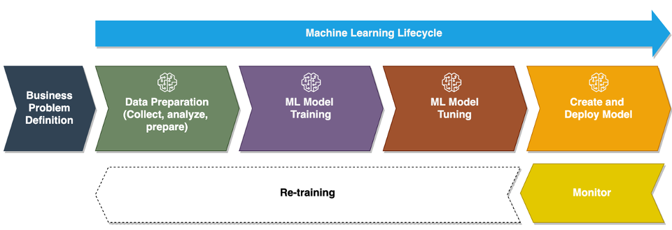
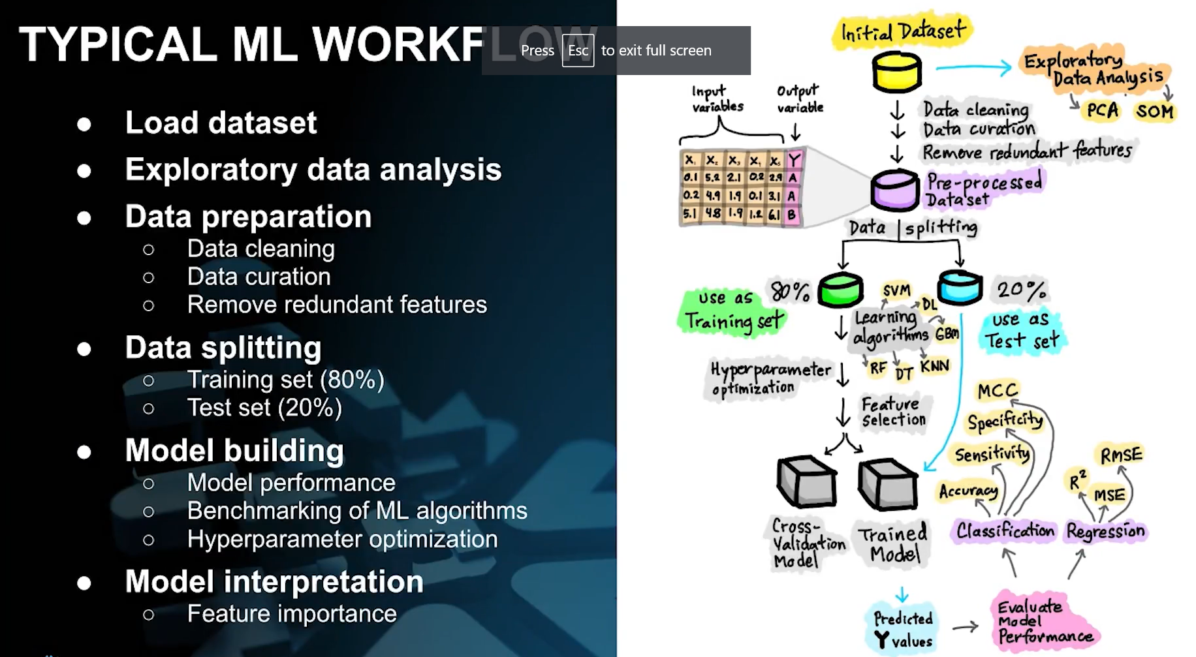
ML Life Cycle
tbd

